Slide 1
- Burst traffic & failure prevention Archi. - DVP Sizing

Slide 2
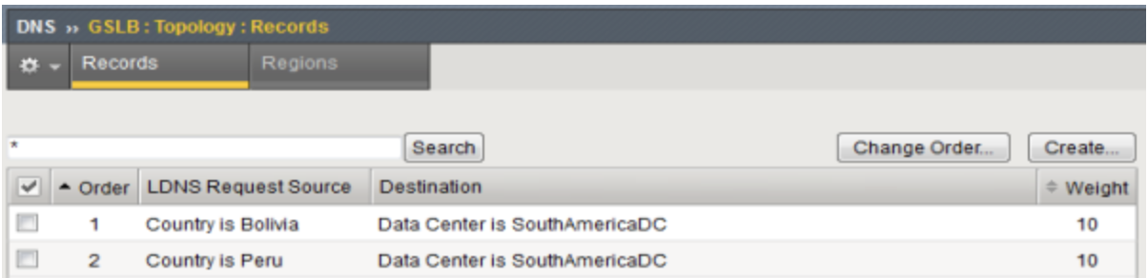
Hybrid Cloud Architecture Overview
We propose an architecture to flexibly handle burst traffic, prevent the spread of failures, and provide stable fail-over services.
No | Description | division
1 | In case of network disconnection caused by Route 53 DNS failure and AZ zone transfer, STB and OTT provide service with zero down time through retry logic. * Refer to page 4 | Fail-Over
2 | In the event of an On premise IDC1,2 failure, the service is provided without downtime by switching from GSLB to AWS. | Fail-Over
3 | To distribute the load of ingress, the load is distributed by distributing the physical routing for authentication, service, and other additional services of the DPV system. * Refer to page 3 | Burst Traffic
4 | When on-premise bulk event calls flow in, only the read API is switched to AWS using APIGW's routing function to protect On-premise services while processing bulk traffic using AWS scalability. * Refer to “Hybrid Architecture v0.9 number 4 | Burst Traffic, Fault tolerance
5 | APIGW provides throttling, load balancing, routing, and circuit breaker functions to ensure service high availability and DVP system stability. * Refer to page 4 | Burst Traffic, Fault tolerance
6 | In the event of a DB failure, MBS provides an authentication-free function and queuing function to provide immediate service and zero service downtime. * Refer to page 6 | Burst Traffic, Faulttolerance
7 | In case of DB Master-standby fail-over, downtime is minimized by building Aurora and application with Advanced JDBC Wrapper Driver. * Refer to page 7 (Aurora Database & AWS Wrapper JDBC) | Fail-Over
1
2
3
3
ingress
ingress
5
4
7
6
Hybrid Architecture v0.9

Slide 3
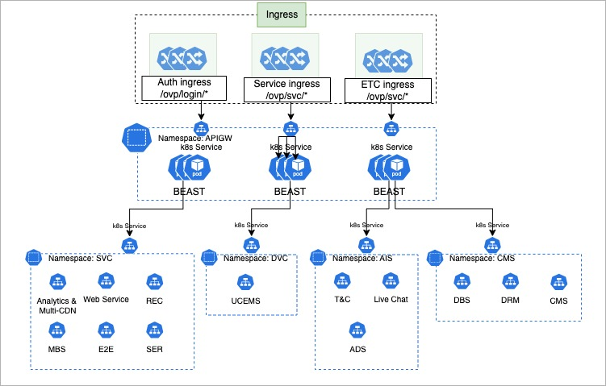
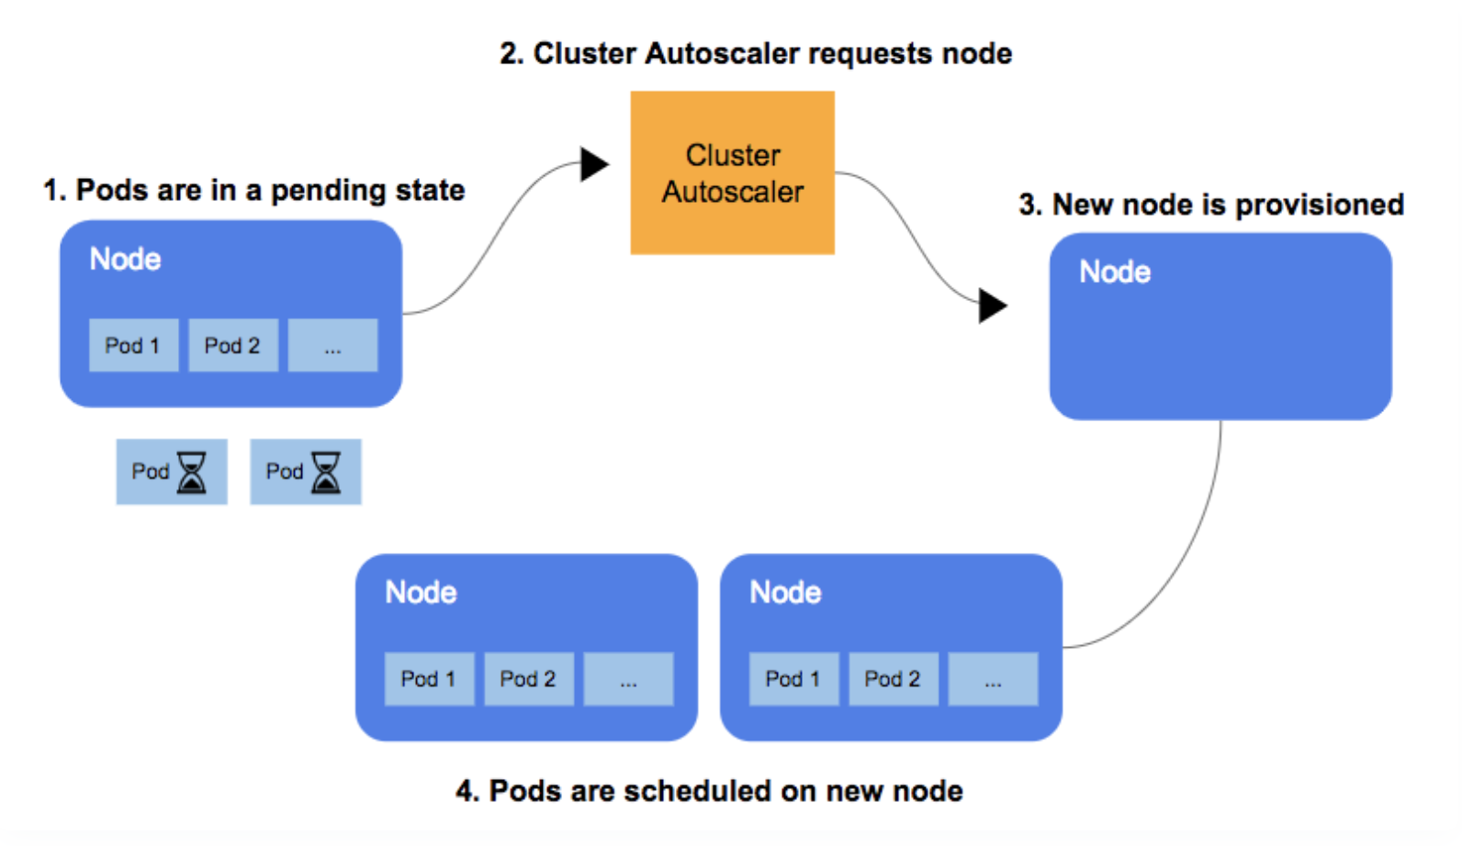
Flexible response to burst traffic
Physical separation according to API traffic provides zero service processing downtime through load balancing.
1 | To distribute the load of ingress, the load is distributed by distributing the physical routing for authentication, service, and other additional services of the DPV system..
2 | APIGW is built as a physical partition in preparation for expected API traffic. Cache: Through Elastic Cache (Redis), frequently viewed data is stored in the cache to reduce database load (API routing information, RateLimit information, authentication information, etc.)
3 | Graceful Degradation Goal: To keep some functions limited even when the system is overloaded with traffic. How to configure: When large-scale traffic received and resources reach their limits, prevent the entire service from being interrupted, maintain core functions (e.g. login, payment) API, and block non-core functions (e.g. recommendation system, notifications) API. reduction
4 | Workaround when traffic increases Situation: As the World Cup begins, a lot of users access DVP system. The number of pods increases rapidly with the Horizontal Pod Autoscaler (HPA), but existing nodes do not provide enough resources to accommodate these pods. Action: Cluster Autoscaler detects that new Pods are not scheduled and are waiting, and requests the Auto Scaling Group to create additional nodes. Result: The number of nodes increases, and waiting Pods are scheduled normally based on the added resources. Despite the surge in traffic, the site is set to operate stably and the service is processed by node scale out.
1
2
Auth gw
SVC gw
3
ETC gw
4

Slide 4
APIGW Burst traffic control method and fault spread prevention function
Circuit break and throttling functions are provided through APIGW to prevent the spread of failures and provide fault tolerance.
API Gateway
Client
Throttling
Providing stable services and preventing the spread of failures
Circuit Breaker pattern application
Use the Circuit Breaker pattern to break down failures between the API gateway and backend services. We can quarantine. This prevents failures in one service from affecting other services.
Failover between Availability Zones
By deploying API Gateway across multiple Availability Zones, if one Availability Zone fails, it automatically switches to another Availability Zone to provide uninterrupted service.
Apply API Throttling
We can avoid overloading your API gateway by using the API Throttling feature, which limits the rate and number of API requests. This increases the availability and reliability of your API Gateway.
Define throttling policy for each service
Service
Service
#1
sec
min
HH
DD
20
-
-
100
MM
BigScreen
-
traffic control
Service
#1
sec
min
HH
DD
-
-
-
-
MM
1000
Based on traffic, 1 item is deducted, and if all are deducted, an HTTP 429 (Too Many Requests) error response is received.
Circuit Breaker
SmallScreen
Define fault propagation blocking policy for each API system
success
service #1
success
division | explanation
Reach time (seconds) | Failure rate aggregation reference period
Minimum number of cases (cases) | Minimum number of traffic occurrences
failure rate(%) | Ratio of number of failures to total number of cases
Block duration (seconds) | blocking duration
service #2
Error (503)
service #3
Fail
blocking
….
success
service #N
ElasticCache/
Redis

Slide 5
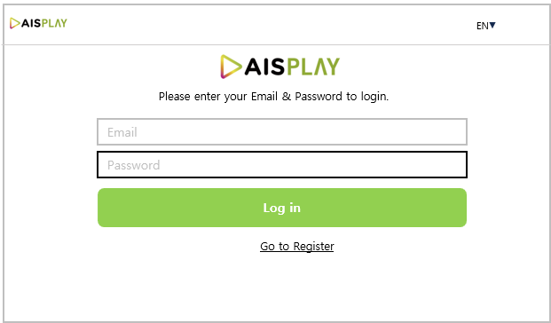



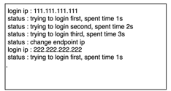


STB, OTT mechanism when service access fails
In case of network disconnection caused by Route 53 DNS failure and AZ zone transfer, STB and OTT provide service with zero down time through retry logic.
STB will attempt to log in to the Master Server of the Private Cloud with 1st URL
In the case of a failed connection to the Master Server in the Private Cloud, try 3 times
If all 3 failed connections, try logging in to the Slave Server in the Private Cloud with 2nd URL
If all 3 failed connections, try logging in to the Master Server in the Public Cloud with 3rd URL
The login status will be displayed on the STB screen like Server IP and retry time
After successful login, run Test VOD to verify normal AV playback
1
Private Cloud
Master Server
Retry 3 times
2
3
5
Private Cloud
Slave Server
4
6
Public Cloud
Master Server

Slide 6
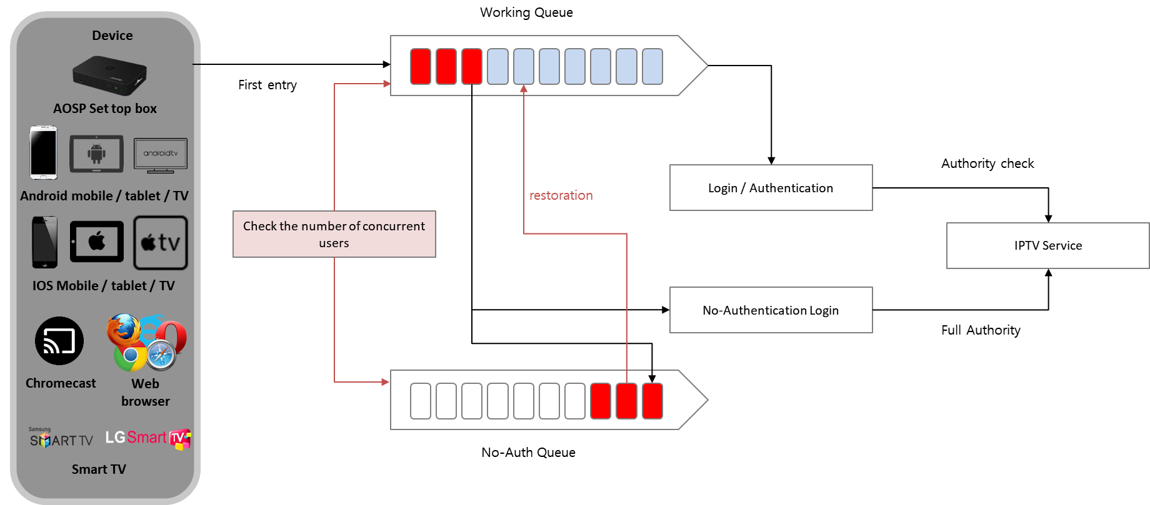
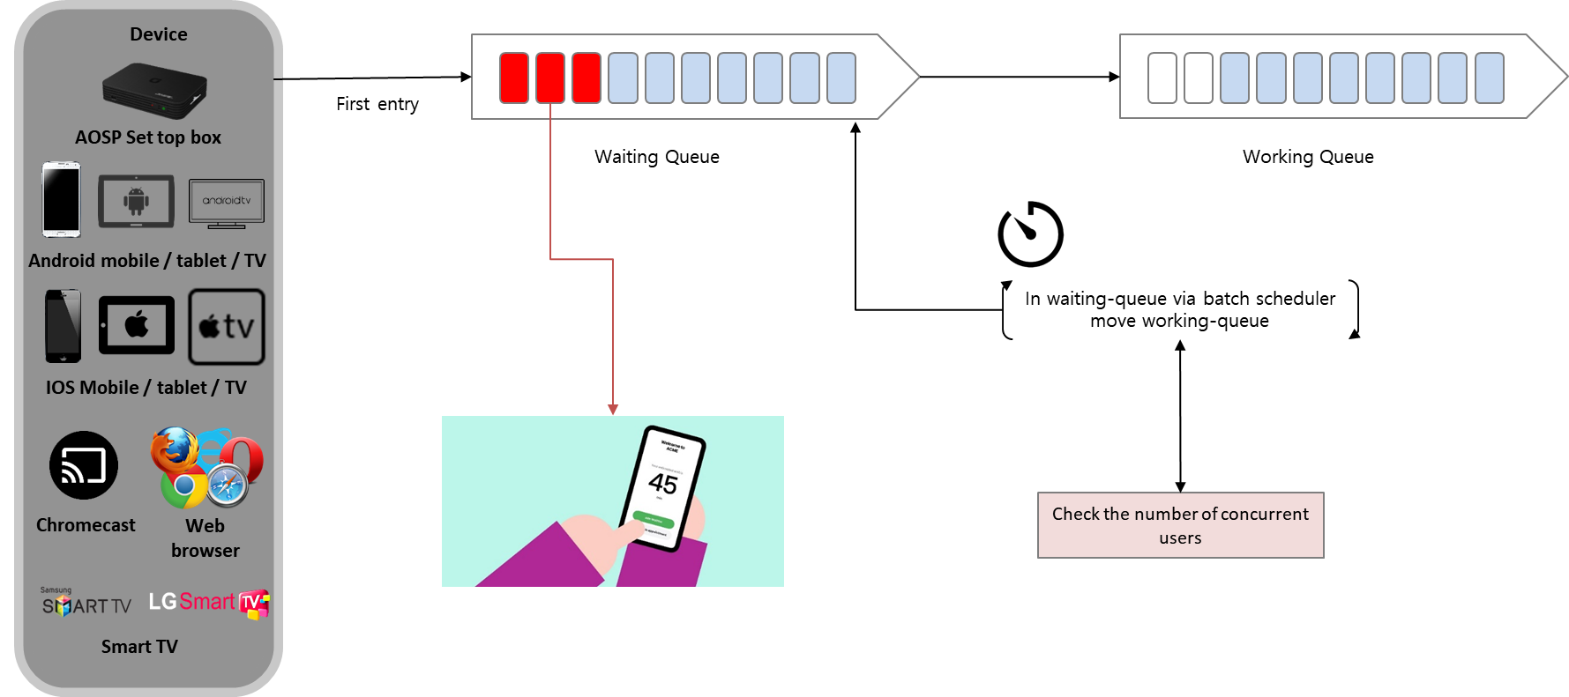
MBS defense logic for continuous service
In the event of a DB failure, MBS provides an authentication-free function and queuing function to provide immediate service and zero service downtime.
No-Auth Service / Waiting Queue Service
Stable service through traffic control when high-capacity traffic occurs (in case of Olympics or World Cup)
No-Auth Service | Waiting Queue Service
The no-auth service temporarily allows all services to be used without logging in during overload.
The waiting-queue service allows only as many users as allowed by the server to enter sequentially.

Slide 7

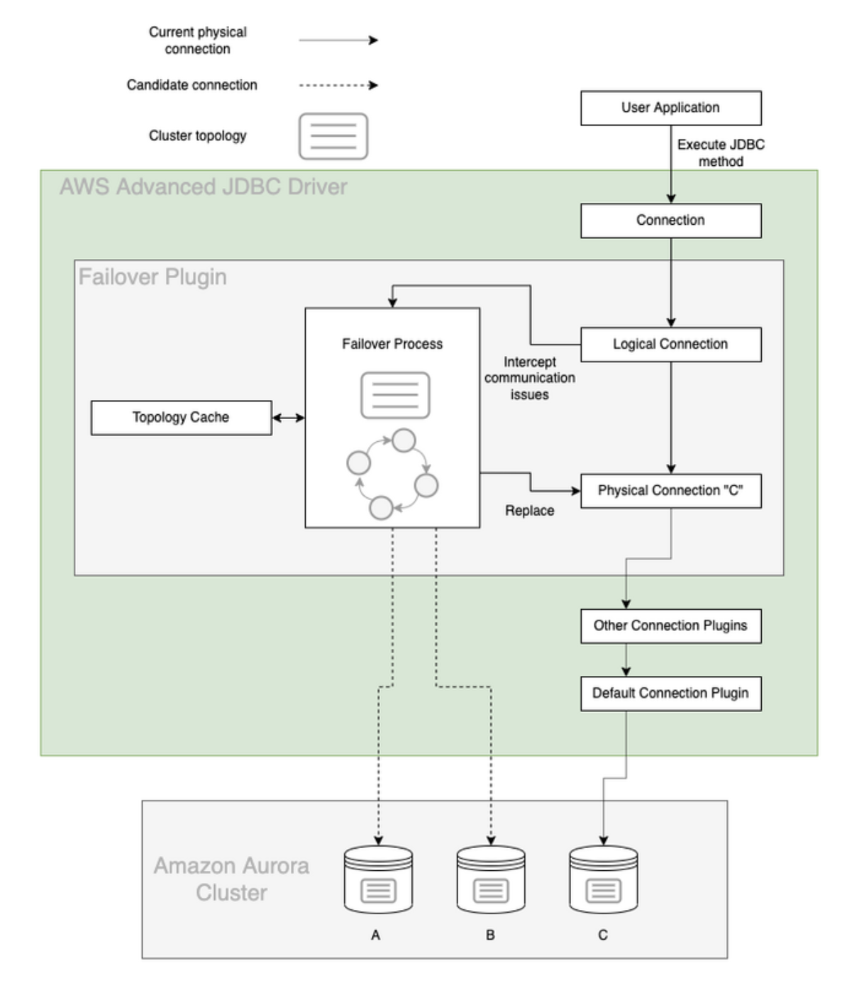
In case of DB failure, quick service recovery by building AWS Wrapper
KT needs design enhancements to improve reliability and scalability for master database failover or to change the database to Aurora Database, which supports master database failover with no downtime.
If the DB cluster has one or more Aurora Replicas, then an Aurora Replica is promoted to the primary instance during a failure event. A failure event results in a brief interruption, during which read and write operations fail with an exception. However, service is typically restored in less than 60 seconds, and often less than 30 seconds. To increase the availability of your DB cluster, we recommend that you create at least one or more Aurora Replicas in two or more different Availability Zones.
Features of the Aurora with Advanced JDBC Wrapper Driver
When a restart of the cluster occurs due to either a change in the parameters of the cluster or a failover, one of the readers is promoted to be the new writer. When this occurs, the cluster writer endpoint is updated to point to the new writer by updating the instance endpoint in the DNS. Due to inherent delays in DNS propagation, this can take up to 30 seconds to resolve. Normally, the application would require logic to reconnect after the temporary lack of availability of the database. The Advanced JDBC Wrapper Driver has built in the capability to automatically detect and switch the connection to the new writer. By utilizing topology information inside the Aurora database, the driver can switch over the connection in around 6 seconds.
Cluster
Endpoint
Reader
Endpoint
Writer
Reader
Reader
SQL
SQL
SQL
Transactions
Transactions
Transactions
Caching
Caching
Caching
CLUSTER STORAGE VOLUME
AZ 1
AZ 2
AZ 3

Slide 8
Sizing Explanation - Public
Pubilc cloud resource
DVP Module Name | AWS Service Type | AWS Spec | Qty | Specification |  | Qty | Specification |  | Qty | Specification |  | Qty | Specification |  | Qty | Specification |  | Qty | Specification |  | Qty | Specification
 |  |  |  | vCPU | MEM (GB) |  | vCPU | MEM (GB) |  | vCPU | MEM (GB) |  | vCPU | MEM (GB) |  | vCPU | MEM (GB) |  | vCPU | MEM (GB) |  | vCPU | MEM (GB)
Common | EKS | Controlplane | 1 |  |  | 1 |  |  | 1 |  |  | 1 |  |  | 1 |  |  | 1 |  |  | 1
CMS | EC2 | c6i.xlarge | 2 | 4 | 8 | 2 | 4 | 8 | 2 | 4 | 8 | 2 | 4 | 8 | 2 | 4 | 8 | 2 | 4 | 8 | 2 | 4 | 8
Web | EC2 | c6i.xlarge | 4 | 4 | 8 | 4 | 4 | 8 | 4 | 4 | 8 | 4 | 4 | 8 | 4 | 4 | 8 | 4 | 4 | 8 | 4 | 4 | 8
DBS | EC2 | c6i.xlarge | 4 | 4 | 8 | 4 | 4 | 8 | 4 | 4 | 8 | 4 | 4 | 8 | 4 | 4 | 8 | 4 | 4 | 8 | 4 | 4 | 8
REC | EC2 | r6i.xlarge | 6 | 4 | 32 | 6 | 4 | 32 | 6 | 4 | 32 | 6 | 4 | 32 | 6 | 4 | 32 | 6 | 4 | 32 | 6 | 4 | 32
SER | EC2 | r6i.xlarge | 6 | 4 | 32 | 6 | 4 | 32 | 6 | 4 | 32 | 6 | 4 | 32 | 6 | 4 | 32 | 6 | 4 | 32 | 6 | 4 | 32
E2E | EC2 | c6i.xlarge | 8 | 4 | 8 | 8 | 4 | 8 | 9 | 4 | 8 | 10 | 4 | 8 | 10 | 4 | 8 | 10 | 4 | 8 | 11 | 4 | 8
MKTG | EC2 | m6i.xlarge | 4 | 4 | 16 | 4 | 4 | 16 | 4 | 4 | 16 | 4 | 4 | 16 | 4 | 4 | 16 | 4 | 4 | 16 | 4 | 4 | 16
MBS GW | EC2 | c6i.xlarge | 8 | 4 | 8 | 9 | 4 | 8 | 9 | 4 | 8 | 10 | 4 | 8 | 10 | 4 | 8 | 10 | 4 | 8 | 11 | 4 | 8
MBS SVC | EC2 | c6i.xlarge | 8 | 4 | 8 | 9 | 4 | 8 | 9 | 4 | 8 | 10 | 4 | 8 | 10 | 4 | 8 | 10 | 4 | 8 | 11 | 4 | 8
UCEMS | EC2 | c6i.xlarge | 8 | 4 | 8 | 9 | 4 | 8 | 9 | 4 | 8 | 10 | 4 | 8 | 10 | 4 | 8 | 10 | 4 | 8 | 11 | 4 | 8
T&C | EC2 | c6i.xlarge | 2 | 4 | 8 | 2 | 4 | 8 | 2 | 4 | 8 | 2 | 4 | 8 | 2 | 4 | 8 | 2 | 4 | 8 | 2 | 4 | 8
Live Chat | EC2 | c6i.xlarge | 4 | 4 | 8 | 4 | 4 | 8 | 4 | 4 | 8 | 4 | 4 | 8 | 4 | 4 | 8 | 4 | 4 | 8 | 4 | 4 | 8
CDN (manifest manipulator) | EC2 | c6i.4xlarge | 4 | 16 | 32 | 5 | 16 | 32 | 6 | 16 | 32 | 6 | 16 | 32 | 7 | 16 | 32 | 7 | 16 | 32 | 8 | 16 | 32
CDN (Admin) | EC2 | c6i.xlarge | 2 | 4 | 8 | 2 | 4 | 8 | 2 | 4 | 8 | 2 | 4 | 8 | 2 | 4 | 8 | 2 | 4 | 8 | 2 | 4 | 8
Expected TPS
 |  | Max capacity ( AZ 1) |  | Max capacity ( AZ 2) |  | Total capacity (AZ1+AZ2)
Year | MAU | Login ( tps ) | Streaming( tps ) | Login ( tps ) | Streaming( tps ) | Login ( tps ) | Streaming( tps )
Year1 | 3,100,000 | 2,000 | 32,000 | 2,000 | 32,000 | 4,000 | 64,000
Year2 | 3,955,000 | 2,250 | 48,000 | 2,250 | 32,000 | 4,500 | 80,000
Year3 | 4,275,500 | 2,250 | 48,000 | 2,250 | 48,000 | 4,500 | 96,000
Year4 | 4,613,050 | 2,500 | 48,000 | 2,500 | 48,000 | 5,000 | 96,000
Year5 | 4,969,355 | 2,500 | 64,000 | 2,500 | 48,000 | 5,000 | 112,000
Year6 | 5,346,291 | 2,500 | 64,000 | 2,500 | 48,000 | 5,000 | 112,000
Year7 | 5,745,920 | 2,750 | 64,000 | 2,750 | 64,000 | 5,500 | 128,000
MBS | core/2*250TPS /2ZONE |  | 2000
Manifest Manipulator for Public Cloud
 | - Required capacity calculation: (Subscriber*0.1)
 | - hls chunk update interval: 5 seconds
 | - required tpms calculation: (subscriber*0.1)/5
 | - proposed tps per core for manifest manipulator: 1,000tps per core
 | - vCPU16 per node is proposed
 | - e.g) vCPU16*2nodes*2 zones=64,000tps support

Slide 9
Sizing Explanation - Hybrid
Pubilc cloud resource
Public
 | Year 2 |  |  | Year 3 |  |  | Year 4 |  |  | Year 5 |  |  | Year 6 |  |  | Year 7
DVP Module Name | Qty | Specification |  | Qty | Specification |  | Qty | Specification |  | Qty | Specification |  | Qty | Specification |  | Qty | Specification
 |  | vCPU | MEM (GB) |  | vCPU | MEM (GB) |  | vCPU | MEM (GB) |  | vCPU | MEM (GB) |  | vCPU | MEM (GB) |  | vCPU | MEM (GB)
Web | 2 | 4 | 8 | 2 | 4 | 8 | 2 | 4 | 8 | 2 | 4 | 8 | 2 | 4 | 8 | 2 | 4 | 8
DBS | 2 | 4 | 8 | 2 | 4 | 8 | 2 | 4 | 8 | 2 | 4 | 8 | 2 | 4 | 8 | 2 | 4 | 8
REC | 4 | 4 | 32 | 4 | 4 | 32 | 4 | 4 | 32 | 4 | 4 | 32 | 4 | 4 | 32 | 4 | 4 | 32
SER | 2 | 4 | 32 | 2 | 4 | 32 | 2 | 4 | 32 | 2 | 4 | 32 | 2 | 4 | 32 | 2 | 4 | 32
E2E | 4 | 4 | 8 | 4 | 4 | 8 | 4 | 4 | 8 | 4 | 4 | 8 | 4 | 4 | 8 | 4 | 4 | 8
MBS GW | 4 | 4 | 8 | 4 | 4 | 8 | 4 | 4 | 8 | 5 | 4 | 8 | 5 | 4 | 8 | 5 | 4 | 8
MBS SVC | 4 | 4 | 8 | 4 | 4 | 8 | 4 | 4 | 8 | 5 | 4 | 8 | 5 | 4 | 8 | 5 | 4 | 8
 |  | Max capacity ( AZ 1) |  | Max capacity ( AZ 2) |  | Total capacity (AZ1+AZ2)
Year | MAU | Login ( tps ) | Streaming( tps ) | Login ( tps ) | Streaming( tps ) | Login ( tps ) | Streaming( tps )
Year1 | 3,100,000 | 2,000 | 32,000 | 2,000 | 32,000 | 4,000 | 64,000
Year2 | 988,750 | 1,000 | 16,000 | 1,000 | 16,000 | 2,000 | 32,000
Year3 | 1,068,875 | 1,000 | 16,000 | 1,000 | 16,000 | 2,000 | 32,000
Year4 | 1,153,263 | 1,000 | 16,000 | 1,000 | 16,000 | 2,000 | 32,000
Year5 | 1,242,339 | 1,250 | 16,000 | 1,250 | 16,000 | 2,500 | 32,000
Year6 | 1,336,573 | 1,250 | 16,000 | 1,250 | 16,000 | 2,500 | 32,000
Year7 | 1,436,480 | 1,250 | 16,000 | 1,250 | 16,000 | 2,500 | 32,000
Private cloud resource
DVP Module Name | Year 2 |  |  | Year 3 |  |  | Year 4 |  |  | Year 5 |  |  | Year 6 |  |  | Year 7
 | Specification/Unit |  | QTY | Specification/Unit |  | QTY | Specification/Unit |  | QTY | Specification/Unit |  | QTY | Specification/Unit |  | QTY | Specification/Unit |  | QTY
 | vCPU | MEM (GB) |  | vCPU | MEM (GB) |  | vCPU | MEM (GB) |  | vCPU | MEM (GB) |  | vCPU | MEM (GB) |  | vCPU | MEM (GB)
WEB | 2 | 4 | 3 | 2 | 4 | 3 | 2 | 4 | 3 | 2 | 4 | 3 | 2 | 4 | 3 | 2 | 4 | 3
DBS | 2 | 4 | 6 | 2 | 4 | 6 | 2 | 4 | 6 | 2 | 4 | 6 | 2 | 4 | 6 | 2 | 4 | 6
REC | 2 | 8 | 15 | 2 | 8 | 15 | 2 | 8 | 15 | 2 | 8 | 15 | 2 | 8 | 15 | 2 | 8 | 15
SER | 2 | 8 | 5 | 2 | 8 | 5 | 2 | 8 | 5 | 2 | 8 | 5 | 2 | 8 | 5 | 2 | 8 | 5
E2E | 2 | 4 | 7 | 2 | 4 | 7 | 2 | 4 | 8 | 2 | 4 | 8 | 2 | 4 | 8 | 2 | 4 | 8
MBS GW | 2 | 4 | 22 | 2 | 4 | 24 | 2 | 4 | 24 | 2 | 4 | 24 | 2 | 4 | 26 | 2 | 4 | 26
MBS SVC | 2 | 4 | 22 | 2 | 4 | 24 | 2 | 4 | 24 | 2 | 4 | 24 | 2 | 4 | 26 | 2 | 4 | 26
Private
 |  | Max capacity ( IDC 1) |  | Max capacity ( IDC 2) |  | Total capacity ( IDC1 +IDC2)
Year | MAU | Login ( | Streaming( tps ) | Login ( tps ) | Streaming( tps ) | Login ( tps ) | Streaming( tps )
Year1 | -
Year2 | 2,966,250 | 5,500 | 64,000 | 5,500 | 64,000 | 11,000 | 128,000
Year3 | 3,206,625 | 6,000 | 96,000 | 6,000 | 96,000 | 12,000 | 192,000
Year4 | 3,459,788 | 6,000 | 96,000 | 6,000 | 96,000 | 12,000 | 192,000
Year5 | 3,727,016 | 6,000 | 96,000 | 6,000 | 96,000 | 12,000 | 192,000
Year6 | 4,009,718 | 6,500 | 96,000 | 6,500 | 96,000 | 13,000 | 192,000
Year7 | 4,309,440 | 6,500 | 96,000 | 6,500 | 96,000 | 13,000 | 192,000
Expected TPS
MBS | core/2pod*250TPS /2Zone |  | In addition to the login API, other APIs were processed and calculated as a buffer to handle burst traffic.
Manifest Manipulator for Public Cloud |  | vCPU16*1*2 zones=32,000 tps
 | - Required capacity calculation: (Subscriber*0.1)
 | - hls chunk update interval: 5 seconds
 | - required tpms calculation: (subscriber*0.1)/5
 | - proposed tps per core for manifest manipulator: 1,000tps per core
 | - vCPU16 per node is proposed
 | - e.g) vCPU16*2*2zones=64,000tps support

Slide 10

Thank you.

